Slide 1
JZTM
Juntoz Tag Manager Component

Slide 2
Tracking Utils
G-Analytics
G-Ads
Client
Web
Fb-Pixel
Criteo

Slide 3
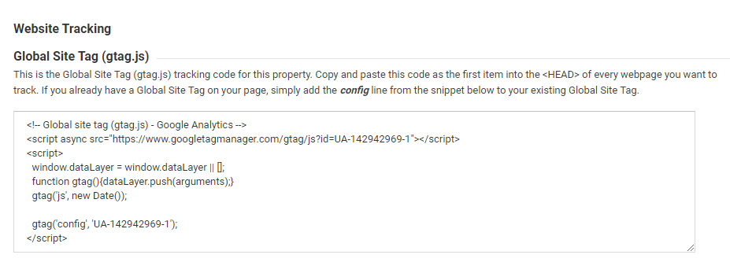
Tracking scripts (GA)

Slide 4
Google Tag Manager
G-Analytics
G-Ads
Client
Web
GTM
Fb-Pixel
Criteo

Slide 5
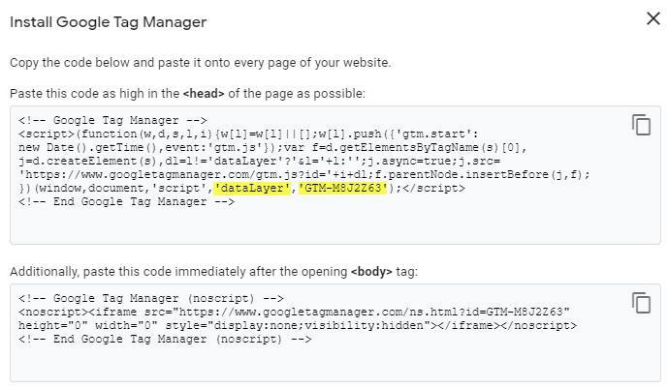
GTM Script

Slide 6
Ecosystem Juntoz
Web Juntoz
G-Analytics
G-Ads
WhiteLabels
Fb-Pixel
Criteo
CheckOut
GTM

Slide 7
GTM to the rescue
G-Analytics
Web Juntoz
G-Ads
WhiteLabels
GTM
Fb-Pixel
CheckOut
Criteo

Slide 8

But, wait a minute GTM !!

Slide 9
We have subdomains (SiS)
G-Analytics
Home
SiS-1
G-Ads
Datalayer
GTM
SiS-2
Fb-Pixel
Datalayer
Datalayer
Criteo
WhiteLabels
CheckOut

Slide 10
Shop in shop model (Current)
GA
Home Jz
Datalayer
GTM-Jz
FB
Cri
GA
SiS-1
Datalayer
GTM-1
FB
Cri
GA
SiS-2
Datalayer
GTM-2
FB
Cri

Slide 11
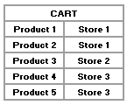
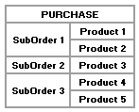
Cart/Purchase Problem
Datalayer
GTM-Jz
CART
GTM-1
Datalayer
Datalayer
GTM-2
Datalayer
GTM-3
Datalayer
GTM-Jz
Purchase
Datalayer
GTM-1
Datalayer
GTM-2
Datalayer
GTM-3

Slide 12

Solution : one datalayer per GTM
Could it be a component?
Comp.
DatalayerJz
GTM-Jz
CART
GTM-1
Datalayer1
Datalayer2
GTM-2
Datalayer3
GTM-3

Slide 13

JZTM was born

Slide 14
What is JZTM?
It is a component created to make the tracking of websites through independent data layers and that allows to send the information to the different renderers currently used. (GA, FB, ADS, CRITEO, GTM)
C1 - Datalayer1 (Renderers : 1,2,3)
C2 - Datalayer2 (Renderers : 1)
C3 - Datalayer3 (Renderers : 1,3)
Renderer 1
Controller 1
Renderer 2
Renderer 3
Config
JZTM
Controller 2
Renderer 1
Renderer 1
Controller 3
Renderer 3

Slide 15
JZTM Workflow
JZTM Config
Query Selector
[JZTMFilter]
Apply()
JZTM Filters
GoogleTagManagerRenderer
Web
JZTM
JuntozTagController
FacebookPixelRenderer
CriteoRenderer

Slide 16
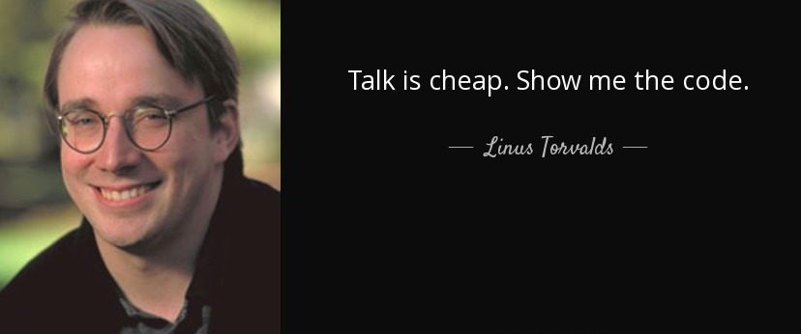
Then...

